Slide 1

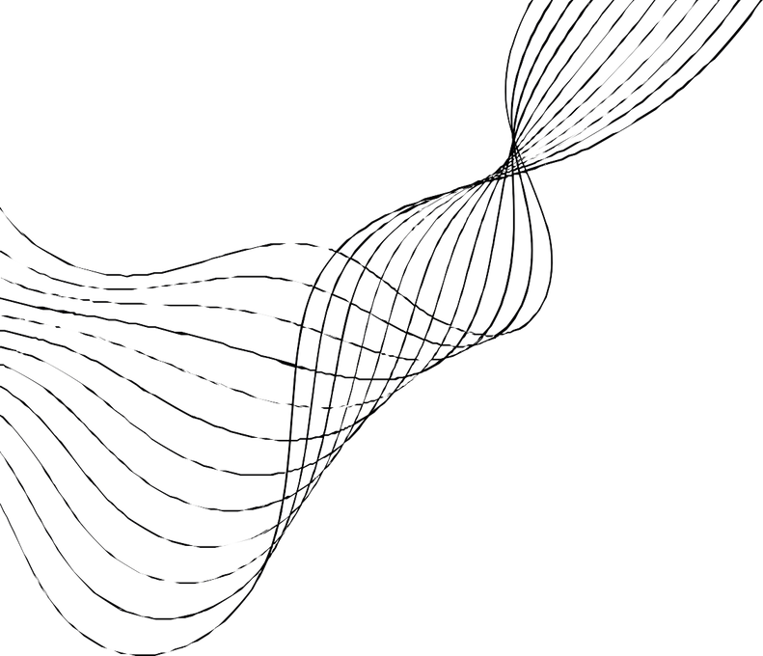
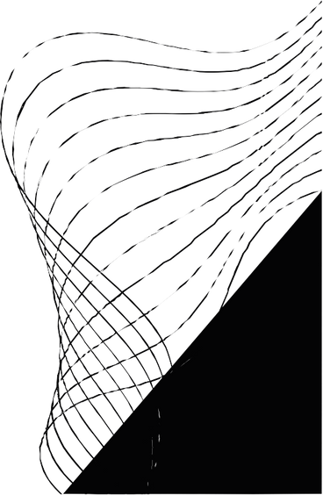
BTL
PROJECT

Slide 2

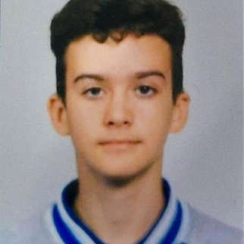
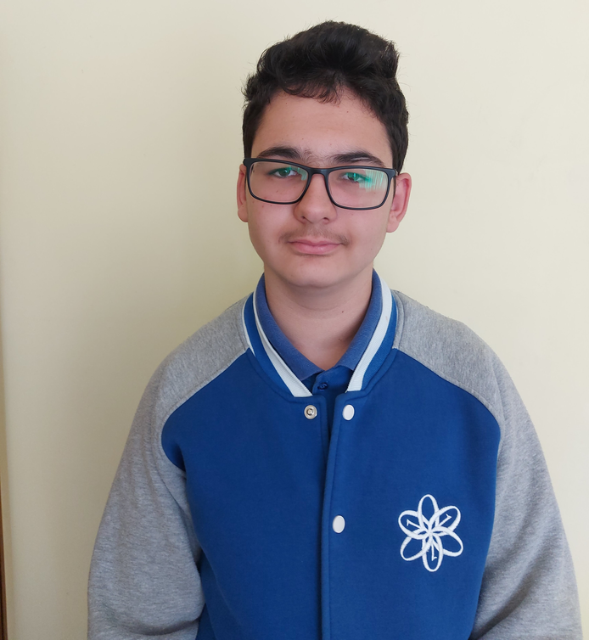
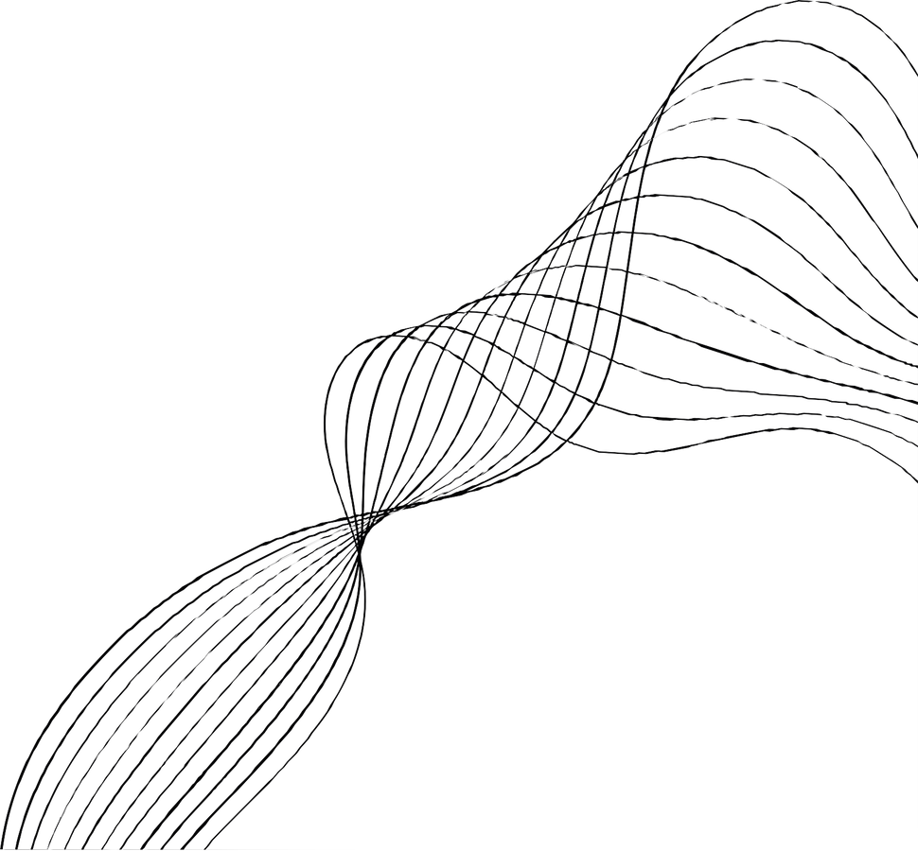
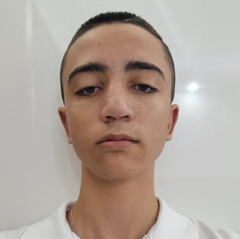
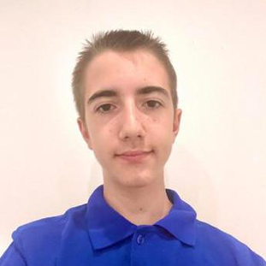
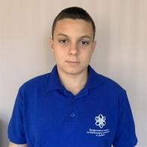
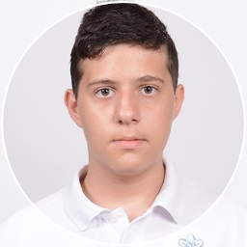
OUR TEAM
Даниел Бузин
Back-end
Станислав Радев
Back-end
Кевин Русев
Back-end
Стелиан Миков
Scrum
Милко Барев
Back-end
Калоян Илиев
Back-end

Slide 3
OUR IDEA

Slide 4

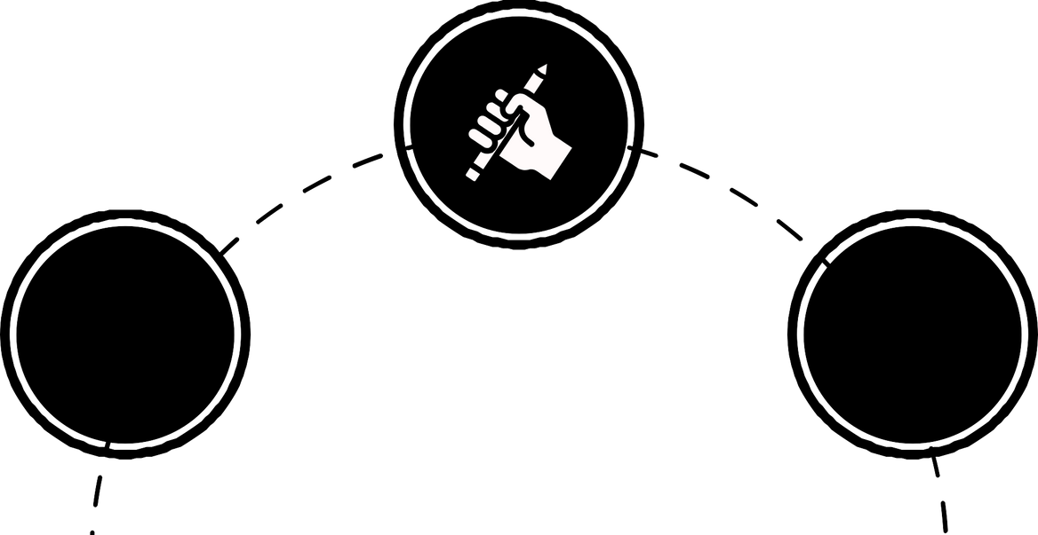
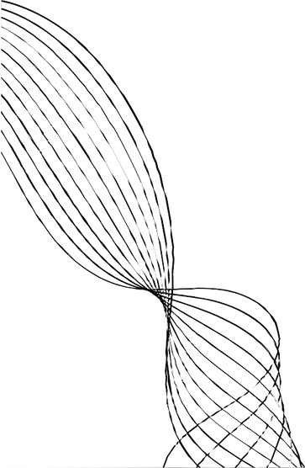



STAGES OF DEVELOPMENT
making the project
Ideas
testing the code

Slide 5









USED TECHNOLOGIES
CODE
LANGUAGE LIBRARY
COMMUNIACTION
DOCUMENTATION
PRESENTATION
PLATFORM

Slide 6

LET’ S JUMP
TO THE CODE

